Slide 1
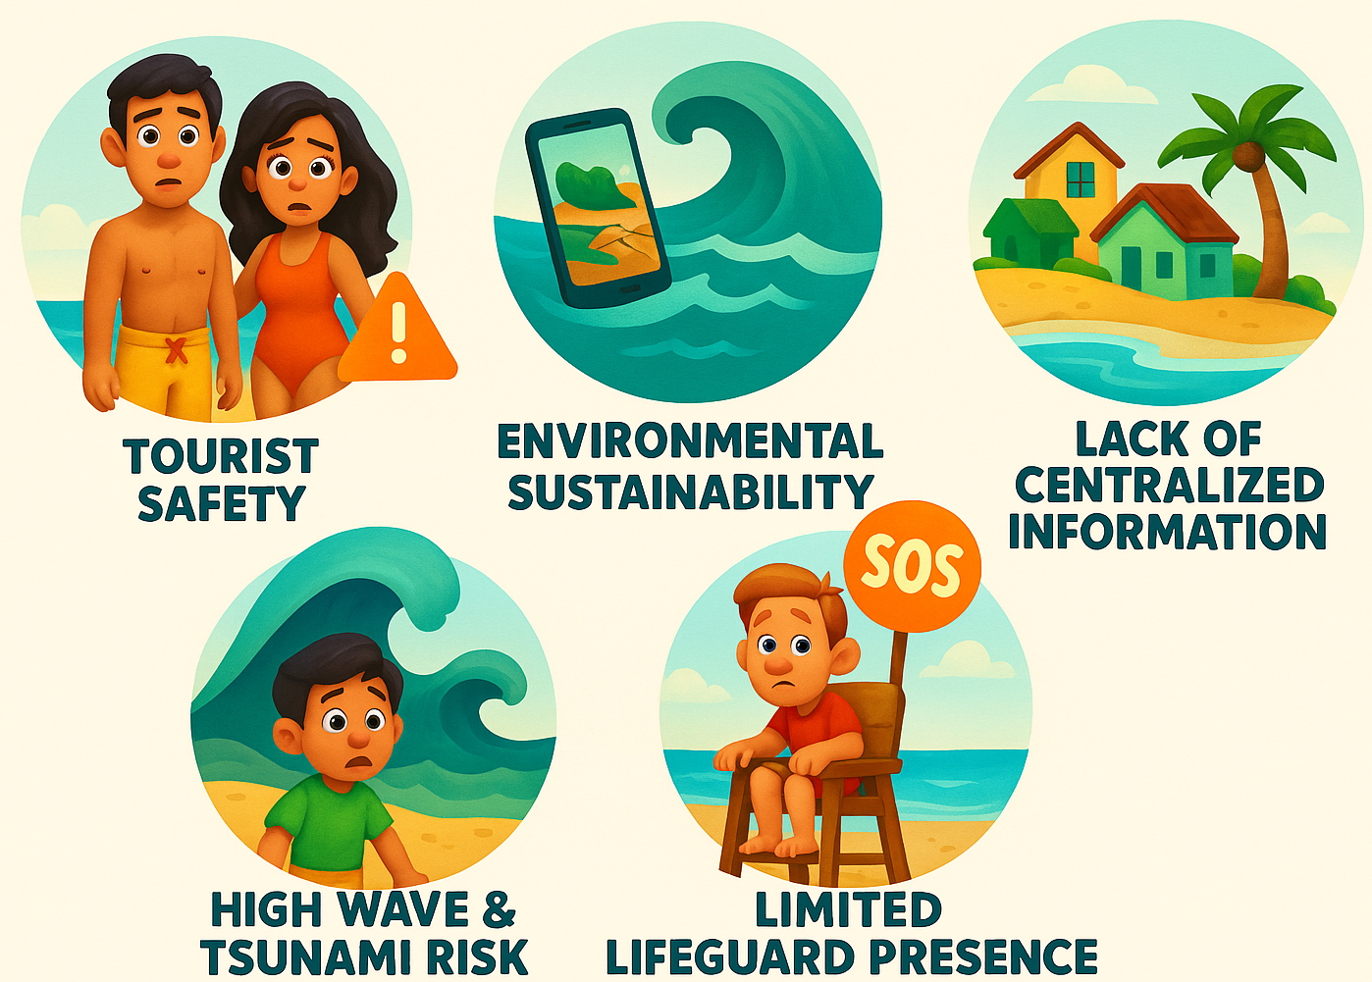
Problem Statement
Problem Statement
Illustration
India's rapidly growing coastal tourism sector, while economically beneficial, faces significant challenges related to tourist safety, environmental sustainability, and the socio-cultural well-being of local communities. A major issue is the lack of a centralized platform providing real-time information on beach safety, weather forecasts, tsunami alerts, and recreational suitability, leaving tourists vulnerable to natural hazards and uncertainty. Coupled with inadequate safety infrastructure, unregulated tourism practices, and socio-environmental degradation, there is an urgent need for a holistic solution that ensures a safer, more informed, and sustainable beach tourism experience across India.

Slide 2
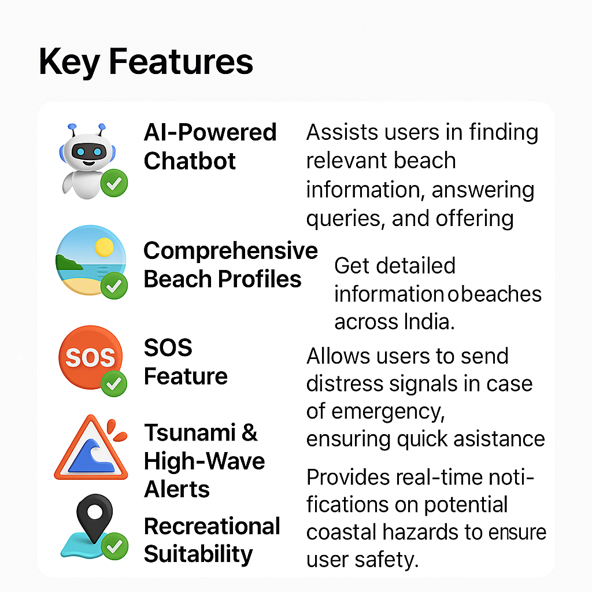
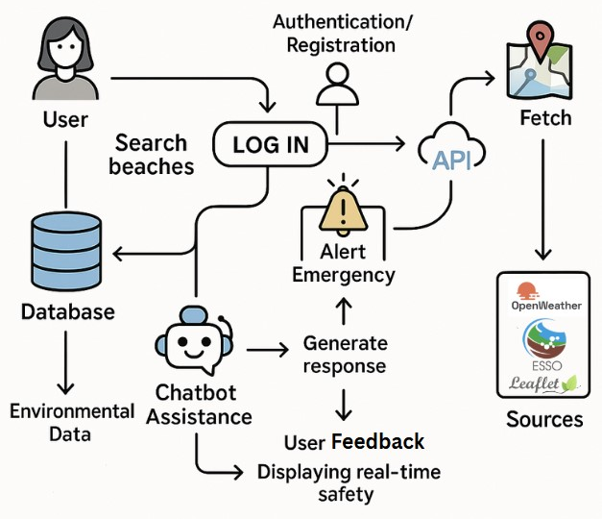
Proposed Solution
Key Features
Application Flow

Slide 3
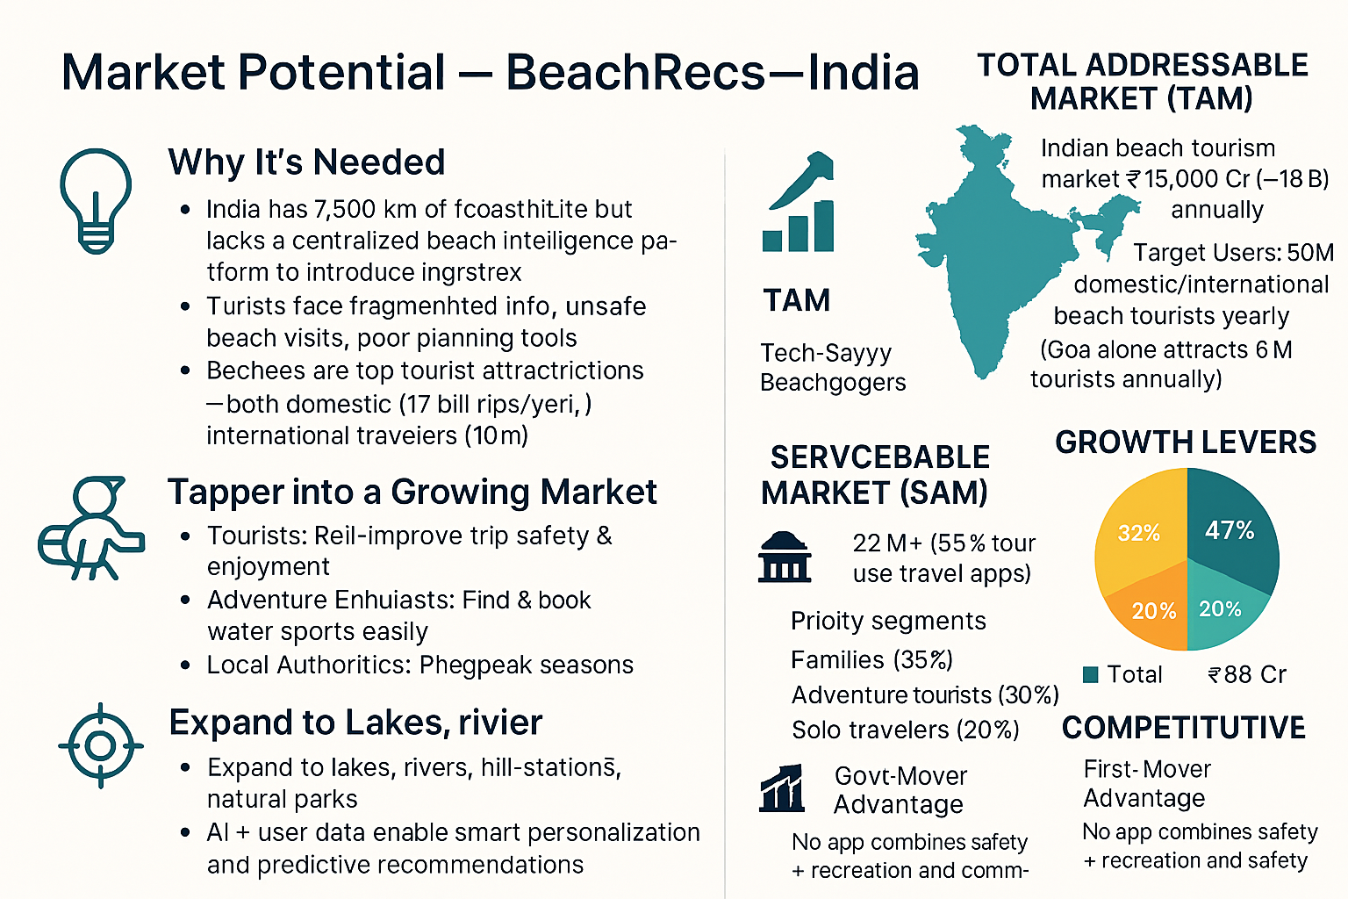
Target Audience
COMPETITIVE

Slide 4
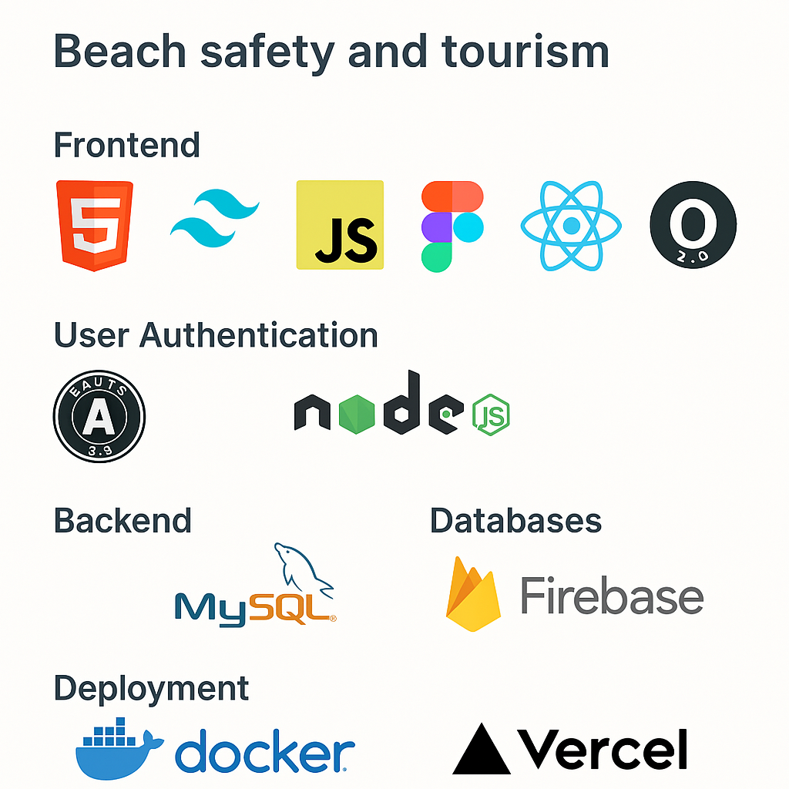
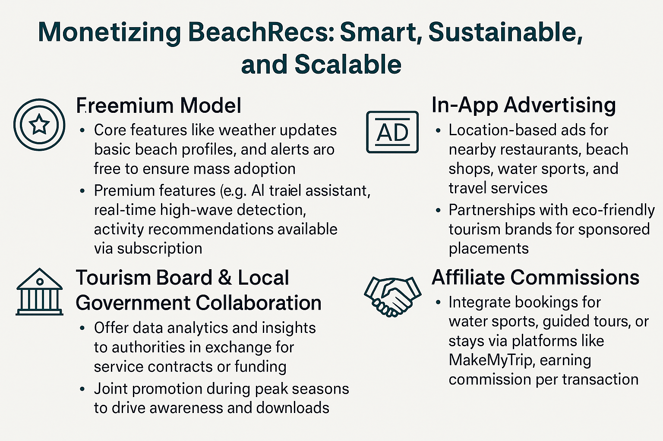

Techstack and Implementation

Slide 5
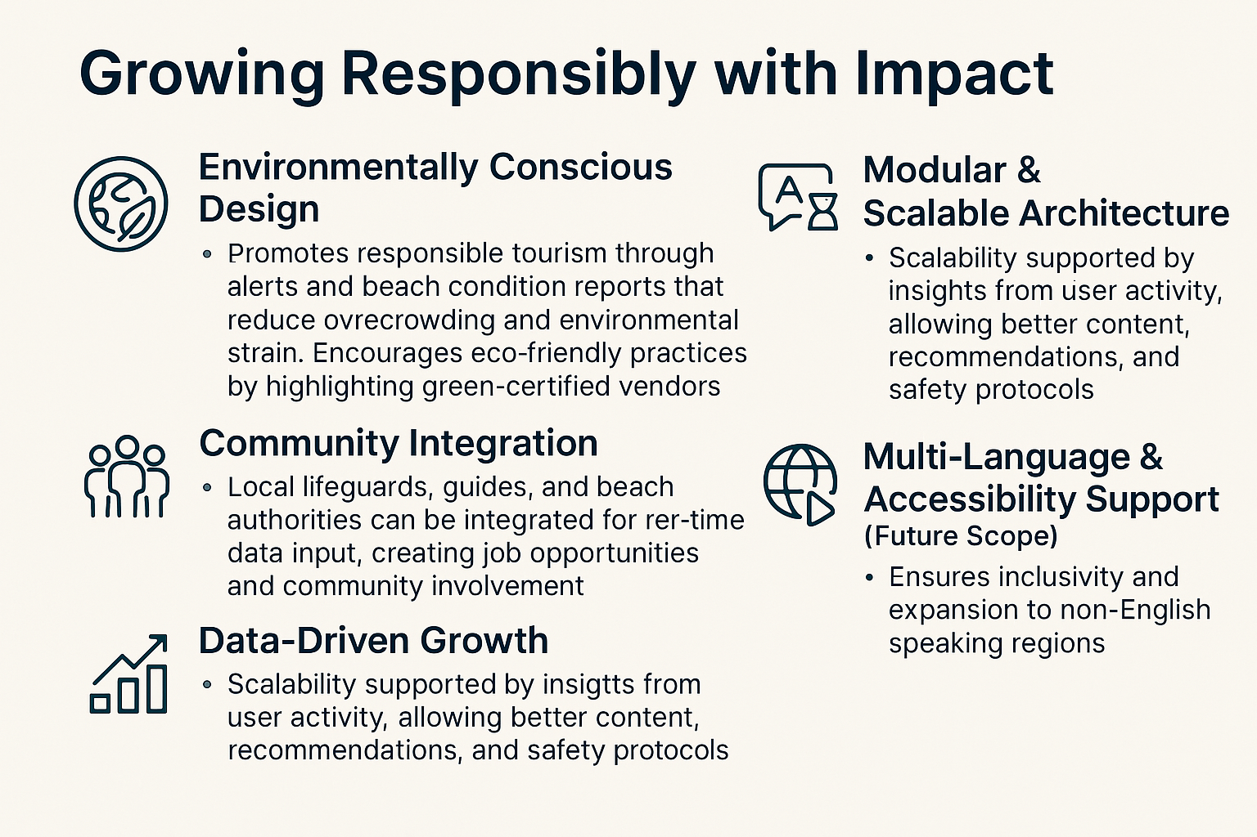
Sustainability & Scalability

